Slide 1

WebAssembly
(also known as)
Wasam

Slide 2

What is WebAssembly ?
Why is it important?
Where is it used?

Slide 3
What is WebAssembly ?

Slide 4
Why is it important?

Slide 5



Where is it used used?

Slide 6

Where is it used used?

Slide 7

Where is it used used?
“WebAssembly cut Figma's load time by 3x”

Slide 8
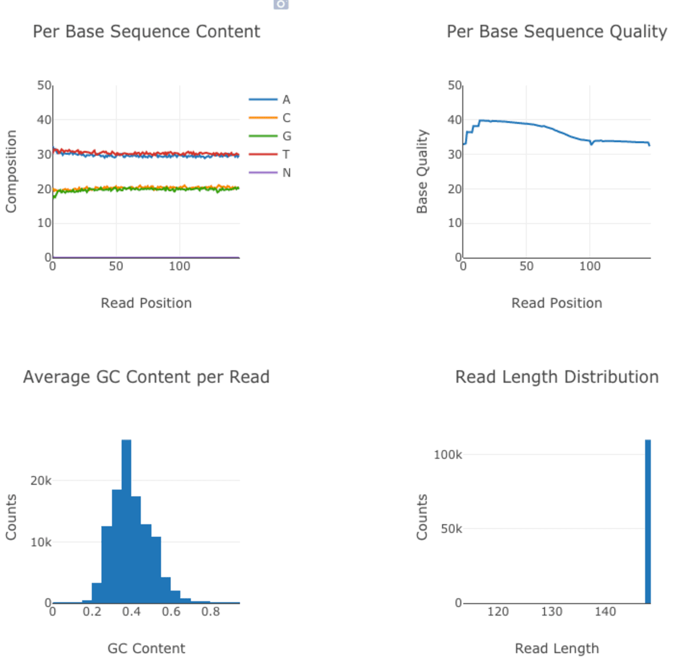
Where is it used used?
How We Used WebAssembly To Speed Up Our Web App By 20X (Case Study)
fastq.bio provides scientists with a quick preview of the quality of their DNA sequencing data

Slide 9

Where is it used used?
Pyodide
...we’re meeting data scientists where they are by bringing the popular and mature Python scientific stack to the browser.

Slide 10

future impact?

Slide 11


What is WebAssembly ?
Why is it important?
Where is it used?
Future impact?

Slide 12


